Slide 1

AI & Robotics Project Presentation
Title: AI Robot Design & Ethics
Subtitle: Conceptual Design and Ethical Analysis
Student: Win Ko Aung
Date: August 2025

Slide 2

Application Domain
Chosen Area: Healthcare
Robots can assist patients, monitor vitals, and help nurses with repetitive tasks.
Aim: Improve patient care and reduce workload on medical staff.

Slide 3
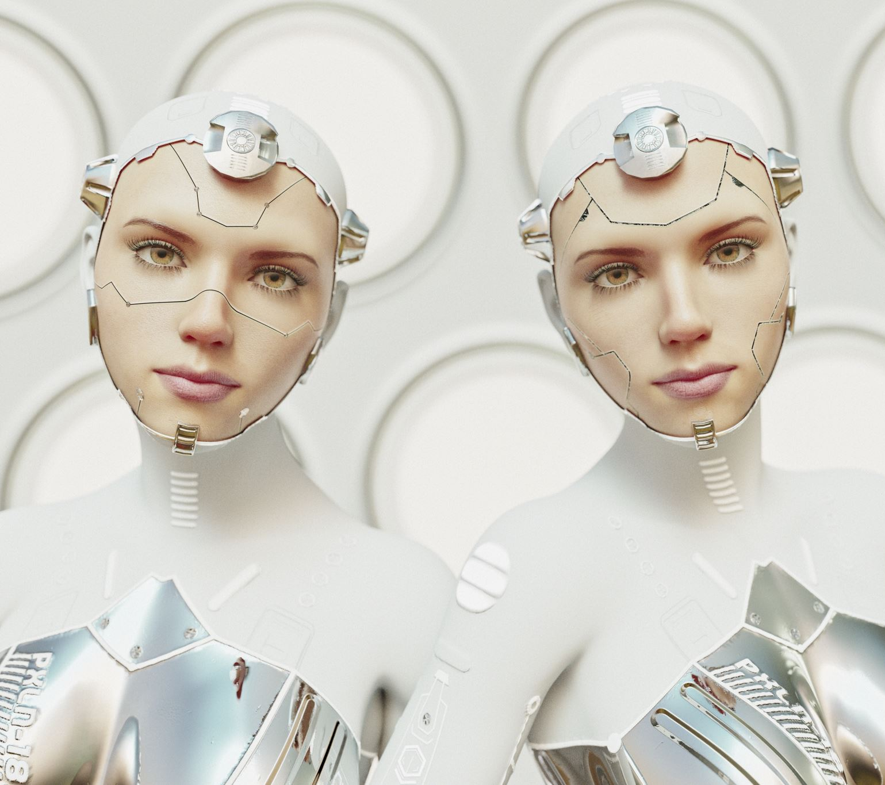
Robot Description
Name: MediBot
Appearance: Human-sized, white casing, wheels for movement, digital face screen
Functions:
Monitor vitals using sensors
Remind patients to take medication
Help patients move around (mobility support)
Communicate with doctors via screen interface

Slide 4

AI and Functionality
AI Capabilities:
Machine Learning for detecting irregular health patterns
Natural Language Processing for speaking with patients
Computer Vision to recognize patient faces and expressions
Sensors Used:
Camera, Microphone, Heart Rate Sensor, Motion Detector
Autonomy: Performs checkups, reminders, and alerts nurses autonomously

Slide 5
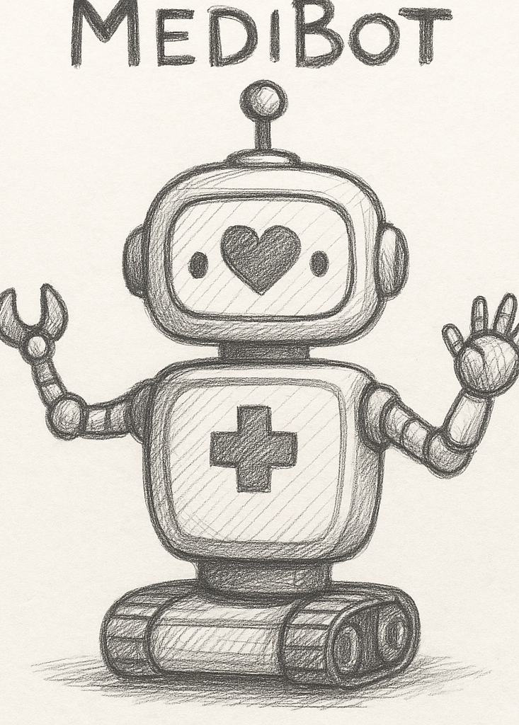
Sketch of MediBot
(Insert your AI-generated or hand-drawn robot sketch here)
Key features labeled:
Screen Interface
Sensor areas
Wheels
Arm extension for carrying small items

Slide 6
Ethical Considerations
Privacy: Handles sensitive medical data; must ensure encryption and limited access
Safety: Must operate in close contact with vulnerable patients without causing harm
Job Displacement: May reduce demand for some support staff roles
Dependency: Patients may become too reliant on robots for emotional support

Slide 7
Mitigation Strategies
Use ethical frameworks (like Asimov's Laws & AI Ethics Guidelines)
Regular audits and transparency reports
Human-in-the-loop design: robot supports but does not replace caregivers
Consent-based data usage

Slide 8
Research Insights
Foundations of AI Robotics: Robin Murphy’s book helped define core architecture
Ethics in AI: Used UNESCO & Nature Machine Intelligence articles for framework
Academic Review: Referenced ArXiv review on AI ethical challenges in health

Slide 9
Conclusion
MediBot combines robotics and AI for meaningful healthcare support
Design focuses on patient safety, ease of use, and ethical responsibility
Next steps: Simulation prototype and user feedback testing

